Slide 1
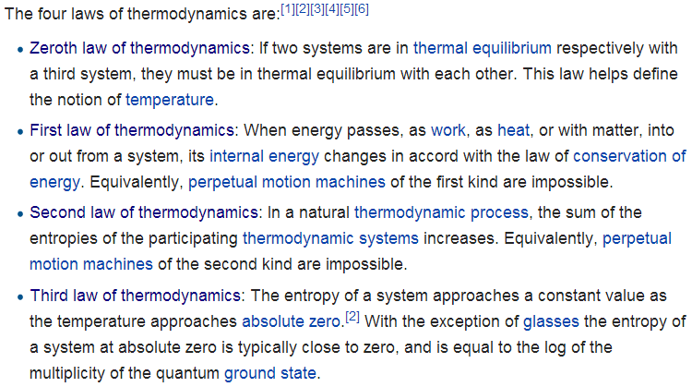
Laws of Thermodynamics
http://en.wikipedia.org/wiki/Laws_of_thermodynamics
Chapter 6
Chapter 17
Fourth law of thermodynamics: Emergent complexity?

Slide 2
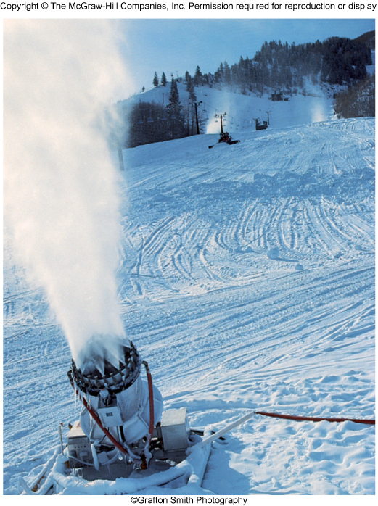
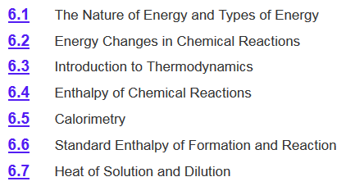
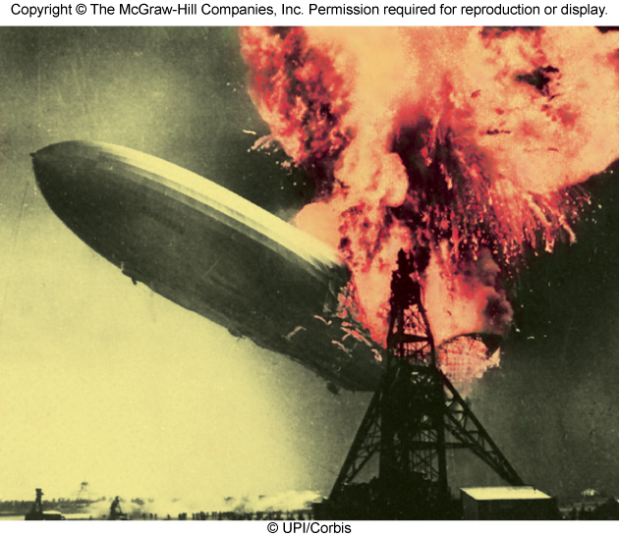
Chapter 6 Review

Slide 3
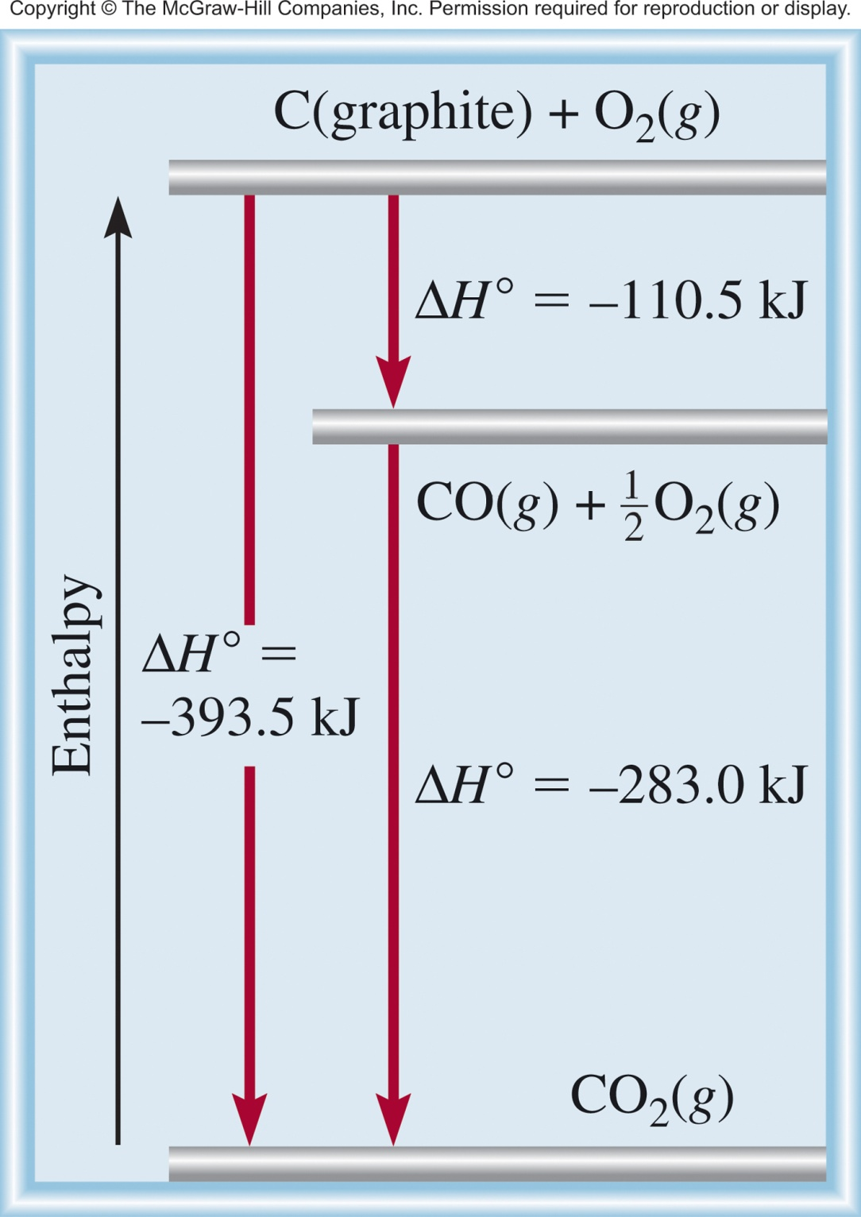
Reaction Enthalpy
Direct Reaction
C (graphite) + O₂ (g) CO₂ (g)
Multistep Reaction
C (graphite) + 1/2O₂ (g) CO (g)
CO (g) + 1/2O₂ (g) CO₂ (g)
C (graphite) + O₂ (g) CO₂ (g)

Slide 4
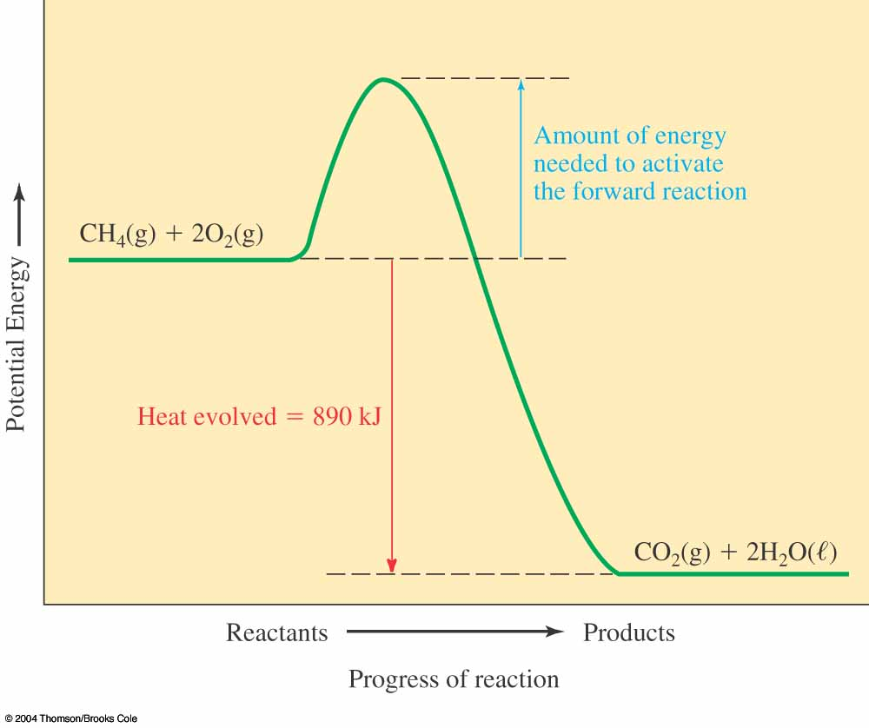
The First Law of Thermodynamics
Exothermic reactions generate specific amounts of heat Q and have a negative enthalpy change:
ΔH = –Q
This is because the potential energies of the products are lower than the potential energies of the reactants.

Slide 5
Chapter 6 Review
Enthalpy (H) is used to quantify the heat flow into or out of a system in a process that occurs at constant pressure.
ΔH_{rxn} = H_{products} – H_{reactants}
H_{products} < H_{reactants}
H_{products} > H_{reactants}
ΔH < 0
ΔH > 0
Exothermic
Endothermic
Enthalpically favorable
Enthalpically unfavorable
If we mix reactants and products together will the reaction occur?
Not enough information. We need to know the change in entropy to predict if a reaction will spontaneously occur.

Slide 6
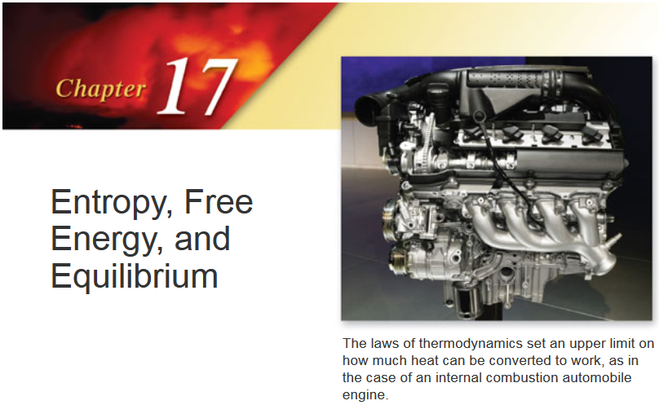

Slide 7
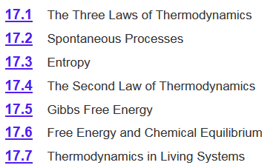
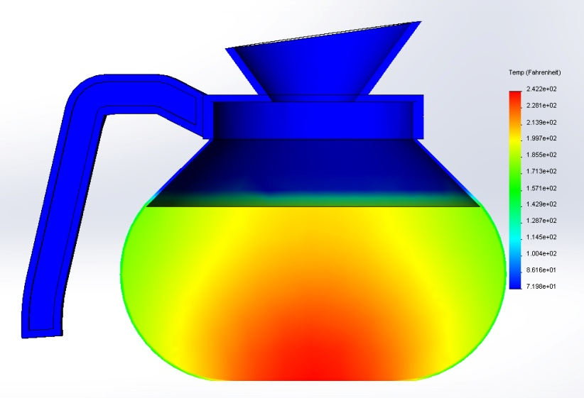
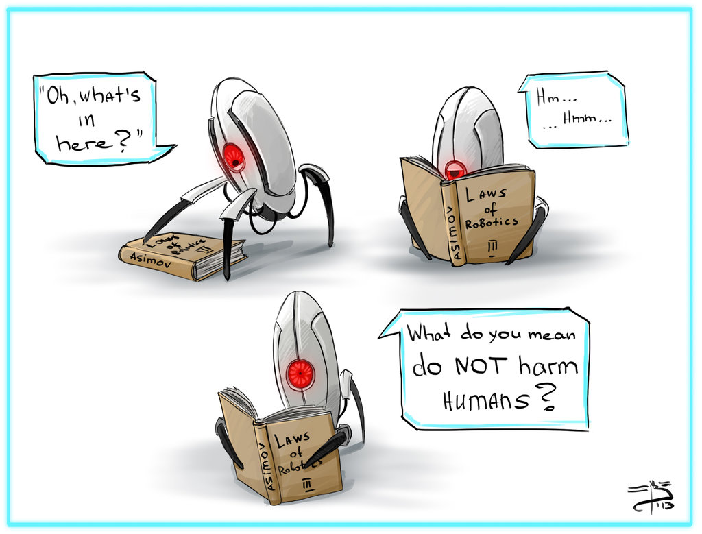
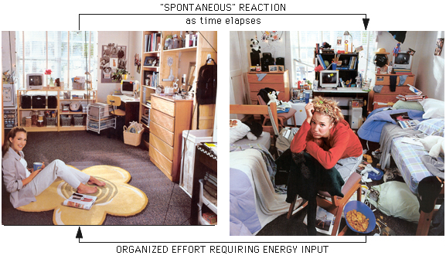
Chapter 17

Slide 8
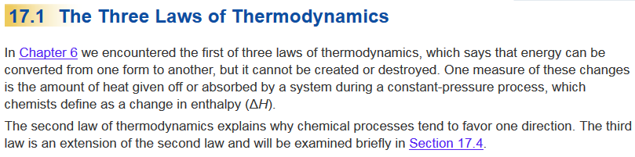
Chapter 17

Slide 9
Chapter 17

Slide 10
Spontaneity
Does something happen?
Spontaneity- the tendency for a process to advance to equilibrium without external influence
Something that happens naturally is spontaneous
Any process will be spontaneous in one direction
The reverse is nonspontaneous
If work needs to be done, it is not spontaneous
Spontaneous: process that does occur under a specific set of conditions
Nonspontaneous: process that does not occur under a specific set of conditions

Slide 11
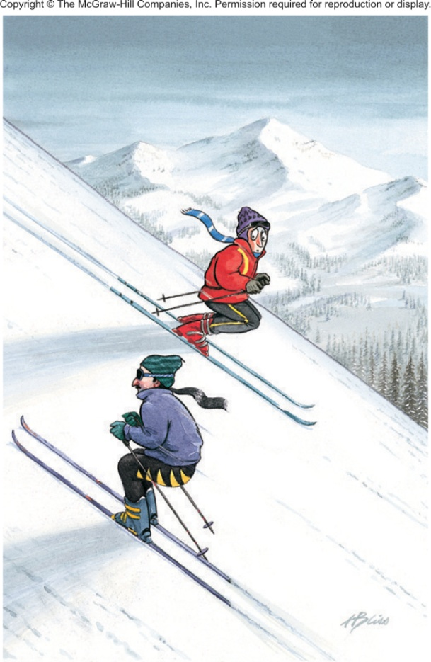
Spontaneity
A waterfall runs downhill
A lump of sugar dissolves in a cup of coffee
Smell diffusing in a room
Heat flows from a hotter object to a colder object
Iron exposed to oxygen and water forms rust
A ball rolling down hill
spontaneous
  Processes that are spontaneous in one direction are nonspontaneous in the reverse direction.
nonspontaneous

Slide 12
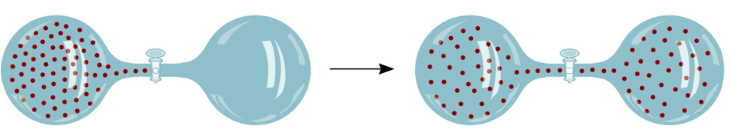
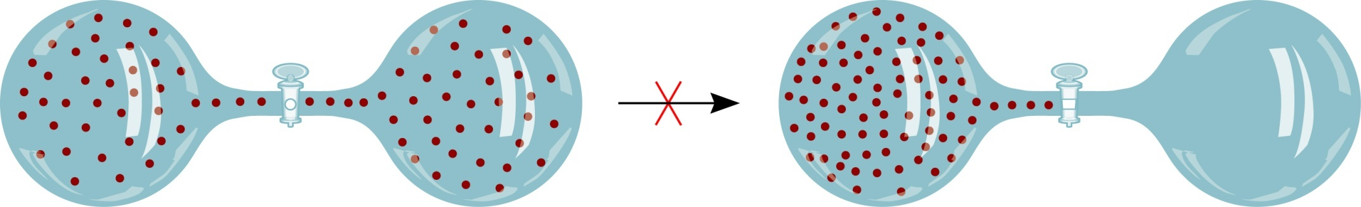
Spontaneity
spontaneous
nonspontaneous

Slide 13
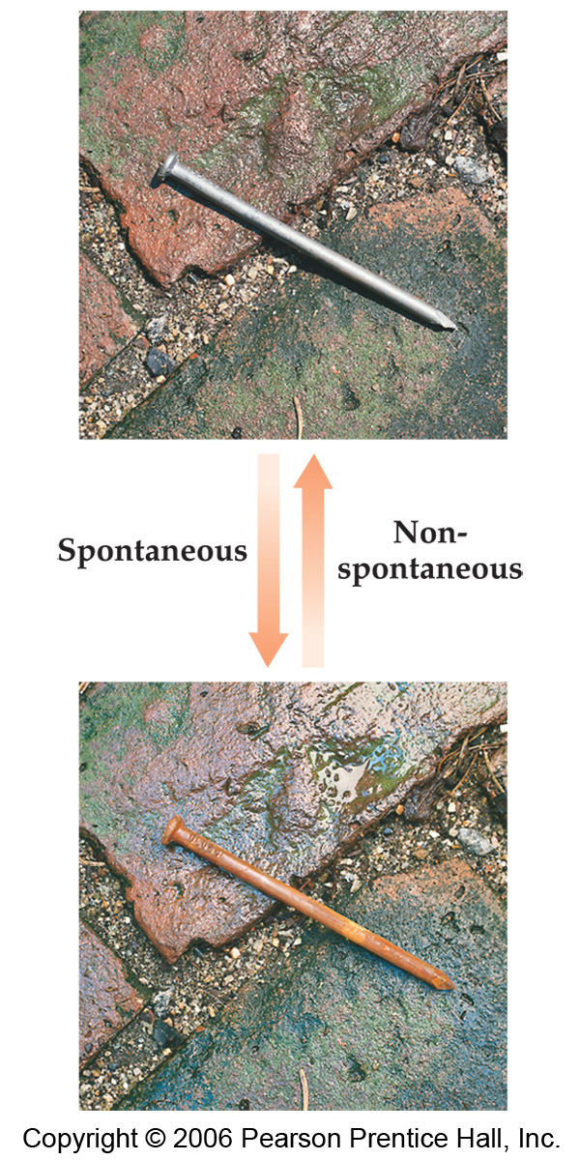
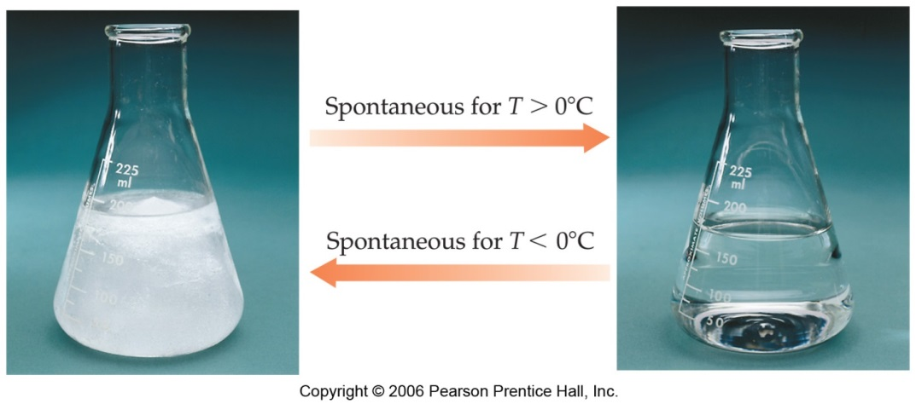
Spontaneity
Processes that are spontaneous at one temperature may be nonspontaneous at other temperatures.
Above 0°C it is spontaneous for ice to melt.
Below 0°C the reverse process is spontaneous.

Slide 14
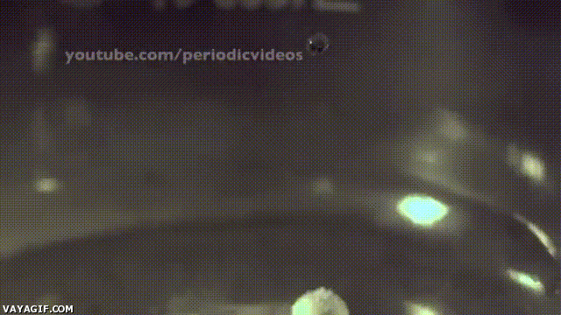
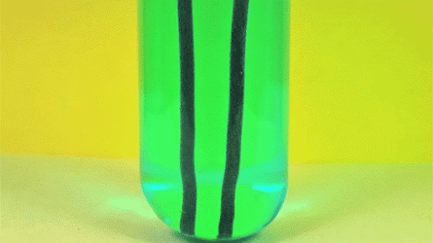
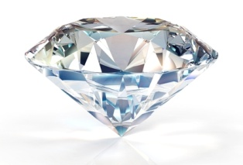

Spontaneity and Speed
The speed of a reaction is not an indicator of its spontaneity.
Spontaneity is determined by the relative positions of the initial and final states (thermodynamic state functions)
Additionally spontaneity does not tell you how fast a reaction is.
Speed is determined by the pathway (kinetics)
Two independent regimes (thermodynamics vs kinetics)
Fast spontaneous process
Slow spontaneous process
Very slow spontaneous process

Slide 15
Spontaneity and Exo/Endothermicity
Spontaneous: process that does occur under a specific set of conditions.
Nonspontaneous: process that does not occur under a specific set of conditions.
Often spontaneous processes are exothermic, but not always….
CH₄ (g) + 2O₂ (g) CO₂ (g) + 2H₂O (l) ΔH⁰ = -890.4 kJ/mol
exothermic
H⁺ (aq) + OH⁻ (aq) H₂O (l) ΔH⁰ = -56.2 kJ/mol
H₂O (s) H₂O (l) ΔH⁰ = 6.01 kJ/mol
endothermic
H₂O
NH₄NO₃ (s) NH₄⁺(aq) + NO₃⁻ (aq) ΔH⁰ = 25 kJ/mol

Slide 16
Spontaneity
If we mix reactants and products together will the reaction occur?
CH₄ (g) + 2O₂ (g) CO₂ (g) + 2H₂O (l) ΔH⁰ = -890.4 kJ/mol
H⁺ (aq) + OH⁻ (aq) H₂O (l) ΔH⁰ = -56.2 kJ/mol
H₂O (s) H₂O (l) ΔH⁰ = 6.01 kJ/mol
H₂O
NH₄NO₃ (s) NH₄⁺(aq) + NO₃⁻ (aq) ΔH⁰ = 25 kJ/mol
Not enough information. We need to know the change enthalpy and in entropy to predict if a reaction will spontaneously occur.

Slide 17
Chapter 17

Slide 18
Entropy
Entropy (S): Can be thought of as a measure of the randomness or disorder of a system.
order
S
disorder
S
- A measure of the loss of information in a transmitted message (Computer science/information theory).
A thermodynamic quantity representing the unavailability of a system's thermal energy for conversion into mechanical work.
A measure of how spread out or dispersed the energy of a system is among the different possible ways a system can contain energy.
- Is a measure of the number of specific ways (microstates) in which a thermodynamic system may be arranged.

Slide 19
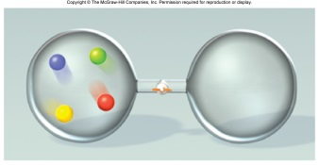
Microstates
Microstates- The detailed microscopic configuration of a system.
How many different ways can a system be arranged.
Red, blue, green and yellow spheres in a two compartment container.

Slide 20
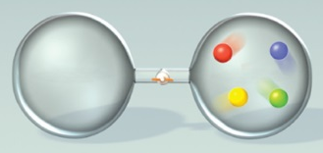
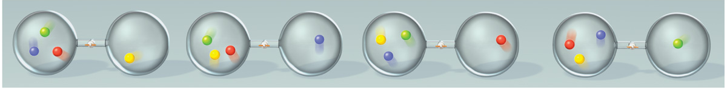
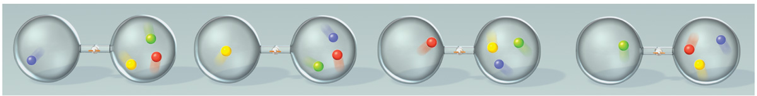
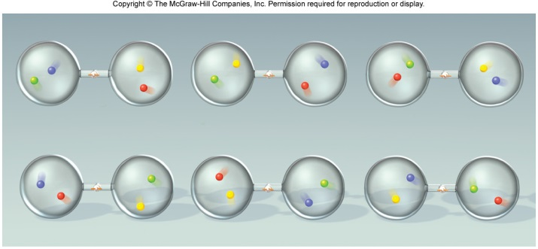
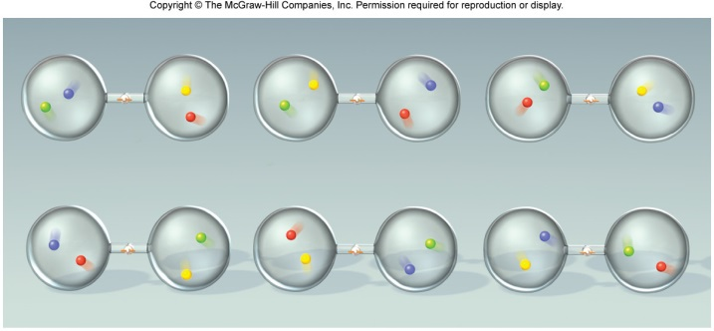
Microstates
Microstates- The detailed microscopic configuration of a system.
How many different ways can a system be arranged.
Red, blue, green and yellow spheres in a two compartment container.
Total microstates = 22
4 and 0 = 2 microstates
3 and 1 = 8 microstates
2 and 2 = 12 microstates

Slide 21


Microstates and Entropy
4 and 0 = 2 microstates
More order, Less entropy
3 and 1 = 8 microstates
2 and 2 = 12 microstates
Less order, more entropy
Configurations (macrostates) associated with large numbers of microstates are said to be more disordered than those with fewer microstates.
The equilibrium state of a system is the most disordered configuration (largest no. of microstates) available.
The number of microstates is called the multiplicity (W) of the configuration.

Slide 22
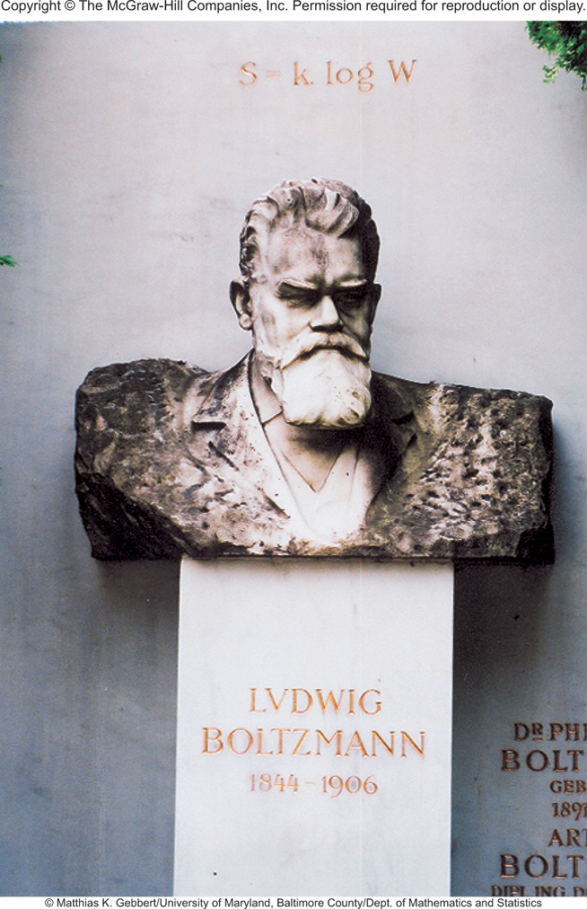
Microstates and Entropy
The Austrian physicist Ludwig Boltzmann introduced a model to relate the total number of microstates (the multiplicity, W) to entropy (S).
Boltzmann constant (k)
S = k ln W
k = 1.38 x 10⁻²³J/K
Gas constant
units on S is J/K
Avogadro constant
Boltzmann was the founding father of statistical mechanics, a completely new way of thinking about theoretical physics. His work was ridiculed by his fellow professors.

Slide 23
Microstates and Entropy
S = k ln W
k = 1.38 x 10⁻²³J/K
4 and 0 = 2 microstates
S = 9.6 x 10⁻²⁵ J/K
More order, Less entropy
3 and 1 = 8 microstates
S = 2.9 x 10⁻²⁴ J/K
2 and 2 = 12 microstates
S = 3.4 x 10⁻²⁴ J/K
Less order, more entropy
has > than 3 times as much entropy as

Slide 24
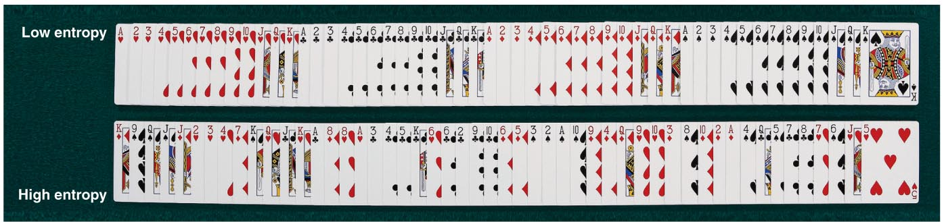
Entropy and Cards
Ordered Deck
W = 1
Unordered Deck
W = (52!) - 1
W = 80658175170943878571660636856403766975289505440883277823999999999999

Slide 25


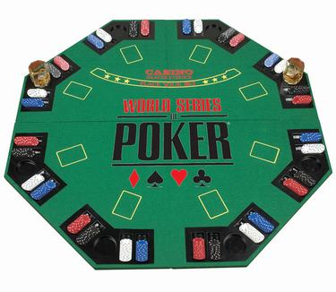




Entropy and Cards
High card
Flush
Full house
Royal Flush
A pair
Three of a kind
Poker: The game that rewards lowest entropy!

Slide 26
Entropy and Cards
Hand | W
Royal flush (AKQJ10 in one suit) | 4
Straight flush (sequence in one suit) | 36
Four of a kind | 624
Full house (three of a kind plus a pair) | 3,744
Flush (five cards in the same suit) | 5,108
Straight (five cards in sequence) | 10,200
Three of a kind | 54,912
Two pairs | 123,552
One pair | 1,098,240
No pairs | 1,302,540
Total | 2,598,960
ln W | S (J/K)
1.39 | 1.92 x 10⁻²³
3.58 | 4.94 x 10⁻²³
6.44 | 8.89 x 10⁻²³
8.23 | 1.14 x 10⁻²²
8.54 | 1.18 x 10⁻²²
9.23 | 1.27 x 10⁻²²
10.91 | 1.51 x 10⁻²²
11.72 | 1.62 x 10⁻²²
13.91 | 1.92 x 10⁻²²
14.08 | 1.94 x 10⁻²²
Poker: The game that rewards the player with the hand that has the least entropy.
Table does not account for high card (the equivalent of enthalpy?).

Slide 27
Entropy and Reactions
“All” chemical and physical changes involve a change in entropy (ΔS) for the system.
A + B C + D
ΔS = S_{f} - S_{i}
S_{initial}
S_{final}
If the change from initial to final results in an increase in randomness and number of states.
S_{f} > S_{i}
ΔS > 0
ΔS = S_{f} - S_{i}
S = k ln W
W_{f} > W_{i} then ΔS > 0
ΔS = k ln W _{f} - k ln W _{i}
W_{f} < W_{i} then ΔS < 0
W_{f}
ΔS = k ln
W_{i}

Slide 28
Entropy and Reactions
“All” chemical and physical changes involve a change in entropy (ΔS) for the system.
A + B C + D
ΔS = S_{f} - S_{i}
S_{initial}
S_{final}
General Molecular Trends:
Structure (gas vs solid, etc.)
less structure =more states = more entropy
Temperature
higher temp = more energy states = more entropy
Number of particles/atoms
more particles = more states = more entropy

Slide 29
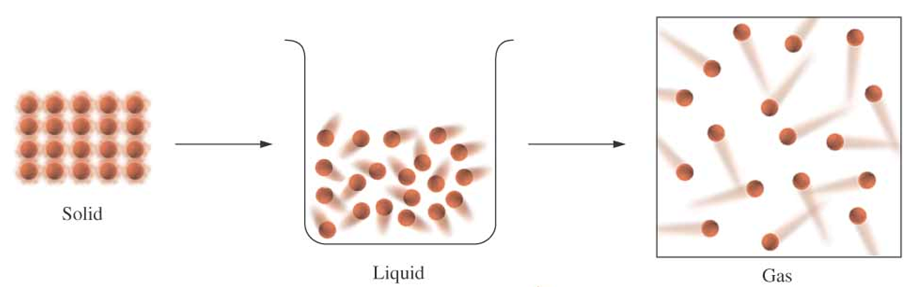
1) Structure/Phase
Increasing disorder
Increasing entropy (S)
For any substance, the solid state is more ordered than the liquid state and the liquid state is more ordered than gas state.
When a gas expands into a vacuum, its entropy increases because the increased volume allows for greater atomic or molecular disorder.
S_{solid} < S_{liquid} << S_{gas}

Slide 30
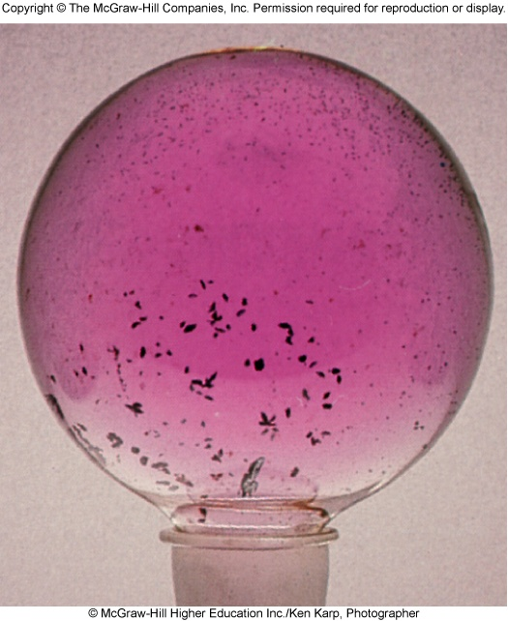
Phase Change
I₂(s) I₂(g)
ΔH = 107 kJ/mol
ΔS > 0

Slide 31
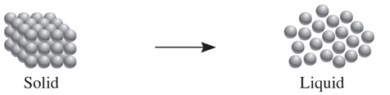
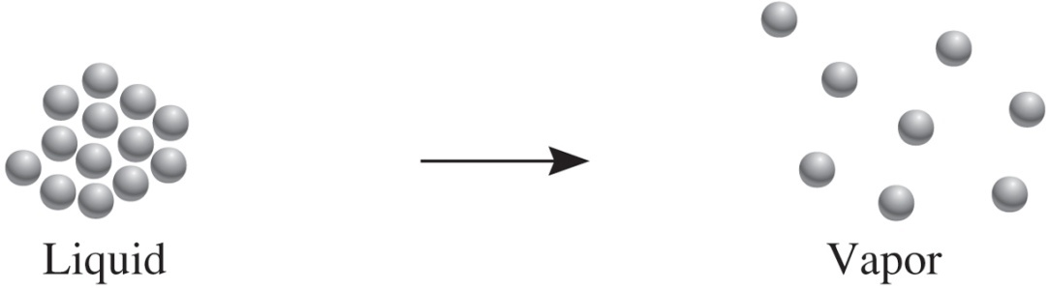
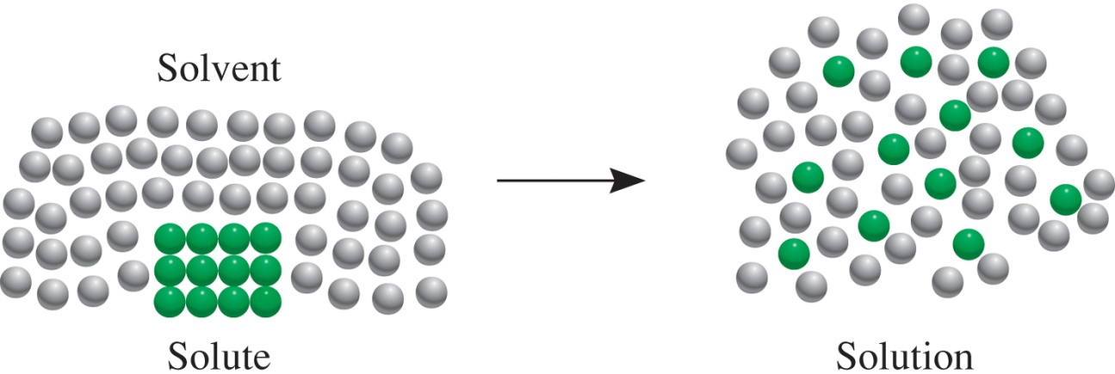
Structure/Phase
Processes that lead to an increase in entropy (ΔS > 0)

Slide 32
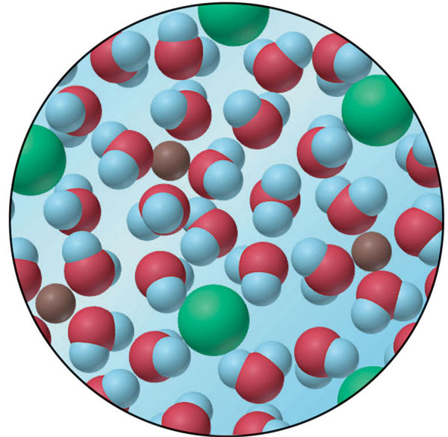
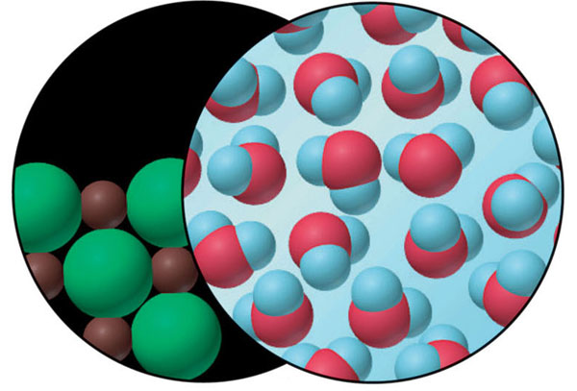
Structure/Phase
The entropy change accompanying the dissolution of a salt
pure solid
MIX
pure liquid
solution
ΔS > 0

Slide 33
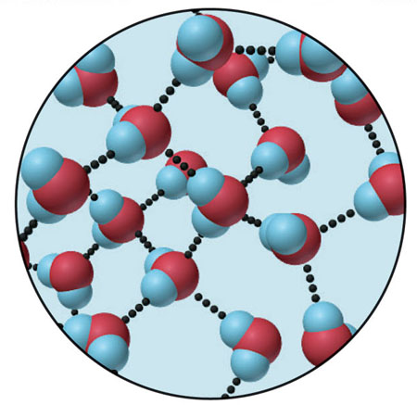
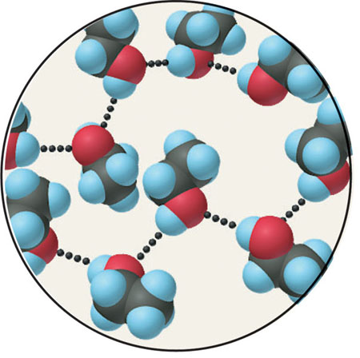
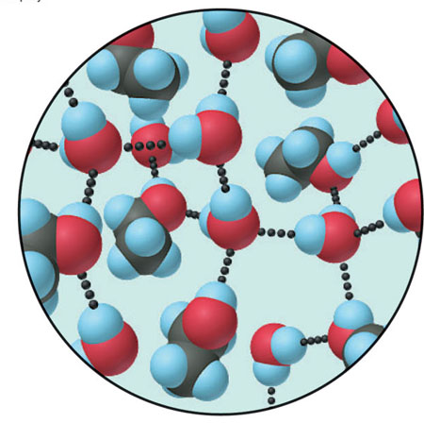
Structure/Phase
The small increase in entropy when ethanol and water mix
MIX
Water
Ethanol
Solution of ethanol and water
ΔS > 0

Slide 34

Entropy and Reactions
“All” chemical and physical changes involve a change in entropy (ΔS) for the system.
A + B C + D
ΔS = S_{f} - S_{i}
S_{initial}
S_{final}
General Molecular Trends:
Structure/Phase (gas vs solid, etc.)
less structure =more states = more entropy
Temperature
higher temp = more energy states = more entropy
Number of particles/atoms
more particles = more states = more entropy

Slide 35
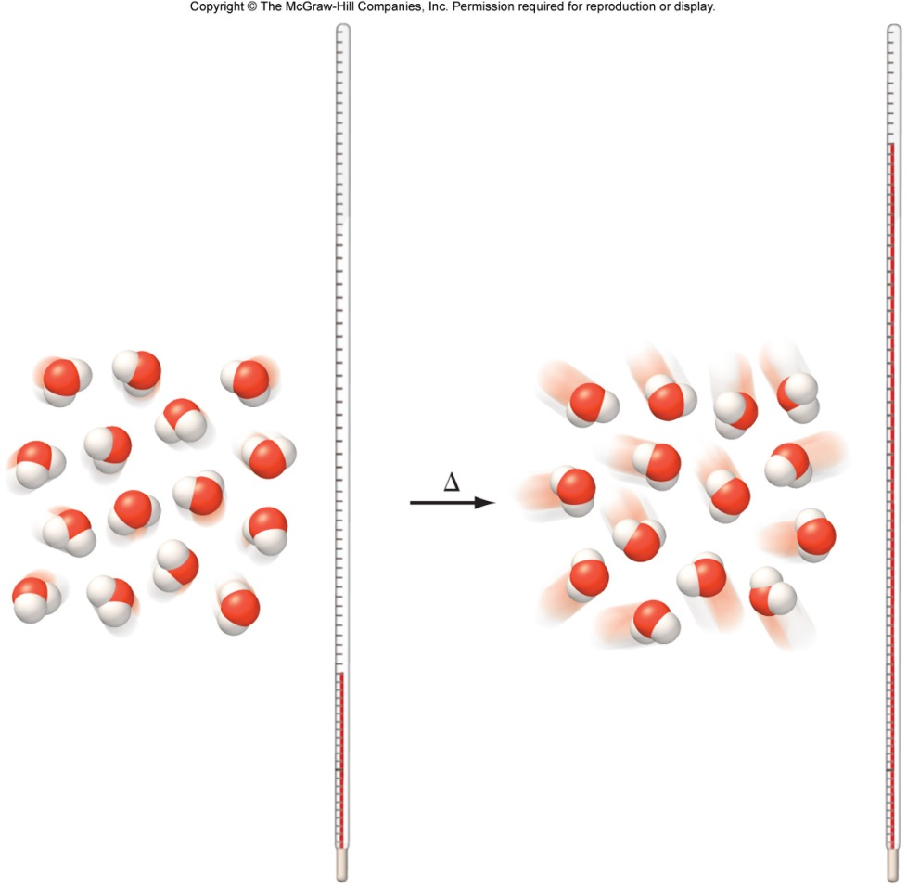
Entropy and Temperature
Entropy increases as temperature increases.
S_{lower temp} < S_{higher temp}
Higher temperature allows the system to access more microstates.

Slide 36
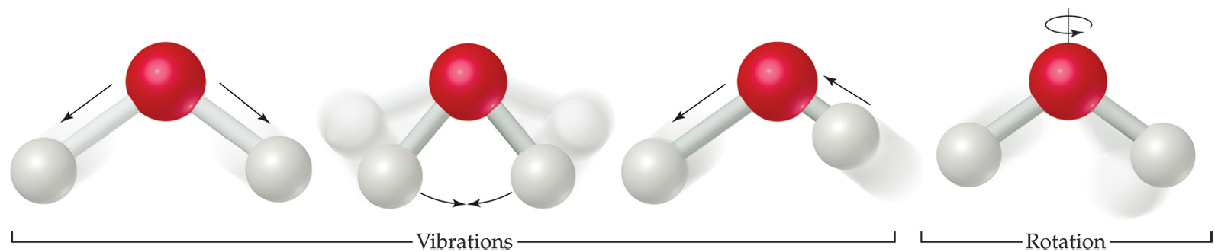
Entropy and Temperature
Molecules exhibit several types of motion:
  Translational: Movement of the entire molecule from one place to another.
  Vibrational: Periodic motion of atoms within a molecule.
  Rotational: Rotation of the molecule on about an axis or rotation about σ bonds.
Higher temperature allows the system to access more vibrational and rotational states (increases microstates).
Notes:
€

Slide 37
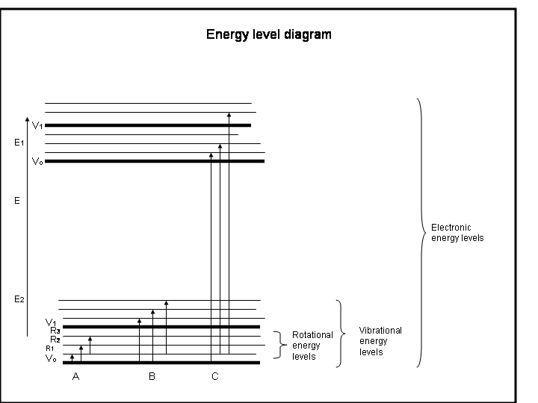
Entropy and Temperature
Higher temperature allows the system to access more vibrational and rotational states (increased # of microstates).
Low temp
High temp

Slide 38
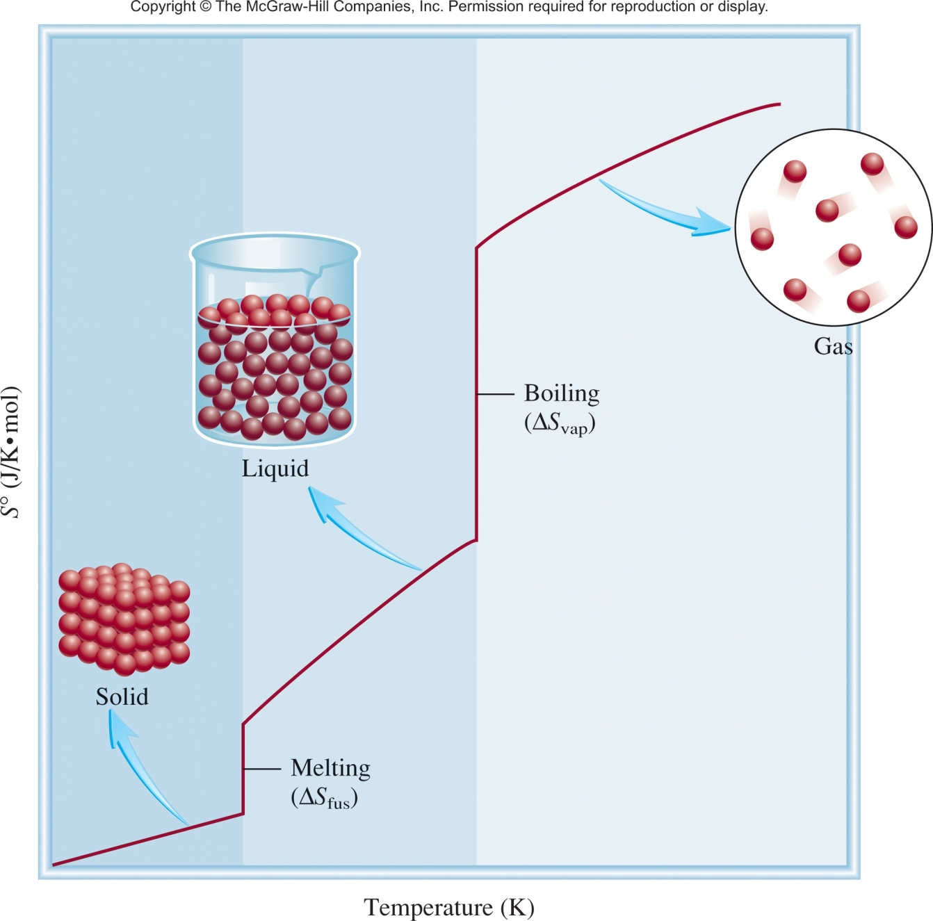
Temperature and Phase Change
S increases slightly with T
S increases a large amount with phase changes

Slide 39
Entropy and Reactions
“All” chemical and physical changes involve a change in entropy (ΔS) for the system.
A + B C + D
ΔS = S_{f} - S_{i}
S_{initial}
S_{final}
General Molecular Trends:
Structure/Phase (gas vs solid, etc.)
less structure =more states = more entropy
Temperature
higher temp = more energy states = more entropy
Number of particles/atoms
more particles = more states = more entropy

Slide 40
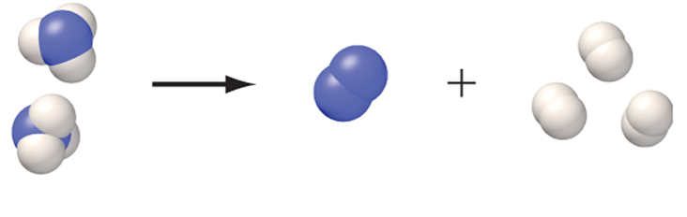

Number of Atoms/Particles
More particles leads to a greater number of microstates (greater S).
2 molecules
4 molecules
S_{fewer moles} < S_{more moles}

Slide 41
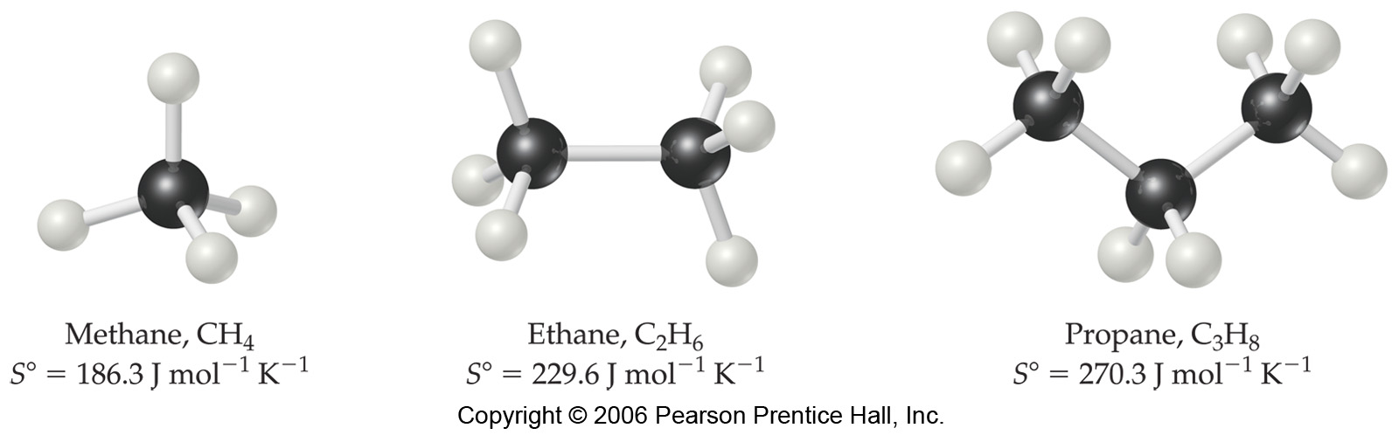
Number of Atoms/Particles
Larger and more complex molecules have greater entropies.
5 atoms
8 atoms
11 atoms
More atoms = more vibrational and rotational states
S_{fewer atoms} < S_{more atoms}

Slide 42
Entropy and Reactions
“All” chemical and physical changes involve a change in entropy (ΔS) for the system.
A + B C + D
ΔS = S_{f} - S_{i}
S_{initial}
S_{final}
General Molecular Trends:
Structure/Phase (gas vs solid, etc.)
less structure =more states = more entropy
Temperature
higher temp = more energy states = more entropy
Number of particles/atoms
more particles = more states = more entropy

Slide 43
17.1
Predict whether the entropy change is greater or less than zero for each of the following processes:
(a) freezing ethanol
(b) evaporating a beaker of liquid bromine
(c) dissolving glucose in water
(d) cooling nitrogen gas from 80°C to 20°C

Slide 44
17.1
Predict whether the entropy change is greater or less than zero for each of the following processes:
(a) freezing ethanol
(b) evaporating a beaker of liquid bromine
(c) dissolving glucose in water
(d) cooling nitrogen gas from 80°C to 20°C
EtOH(l) → EtOH(s)
ΔS < 0
Br₂(l) → Br₂ (g)
ΔS > 0
C₆H₁₂O₆(s) → C₆H₁₂O₆ (aq)
ΔS > 0
ΔS < 0

Slide 45
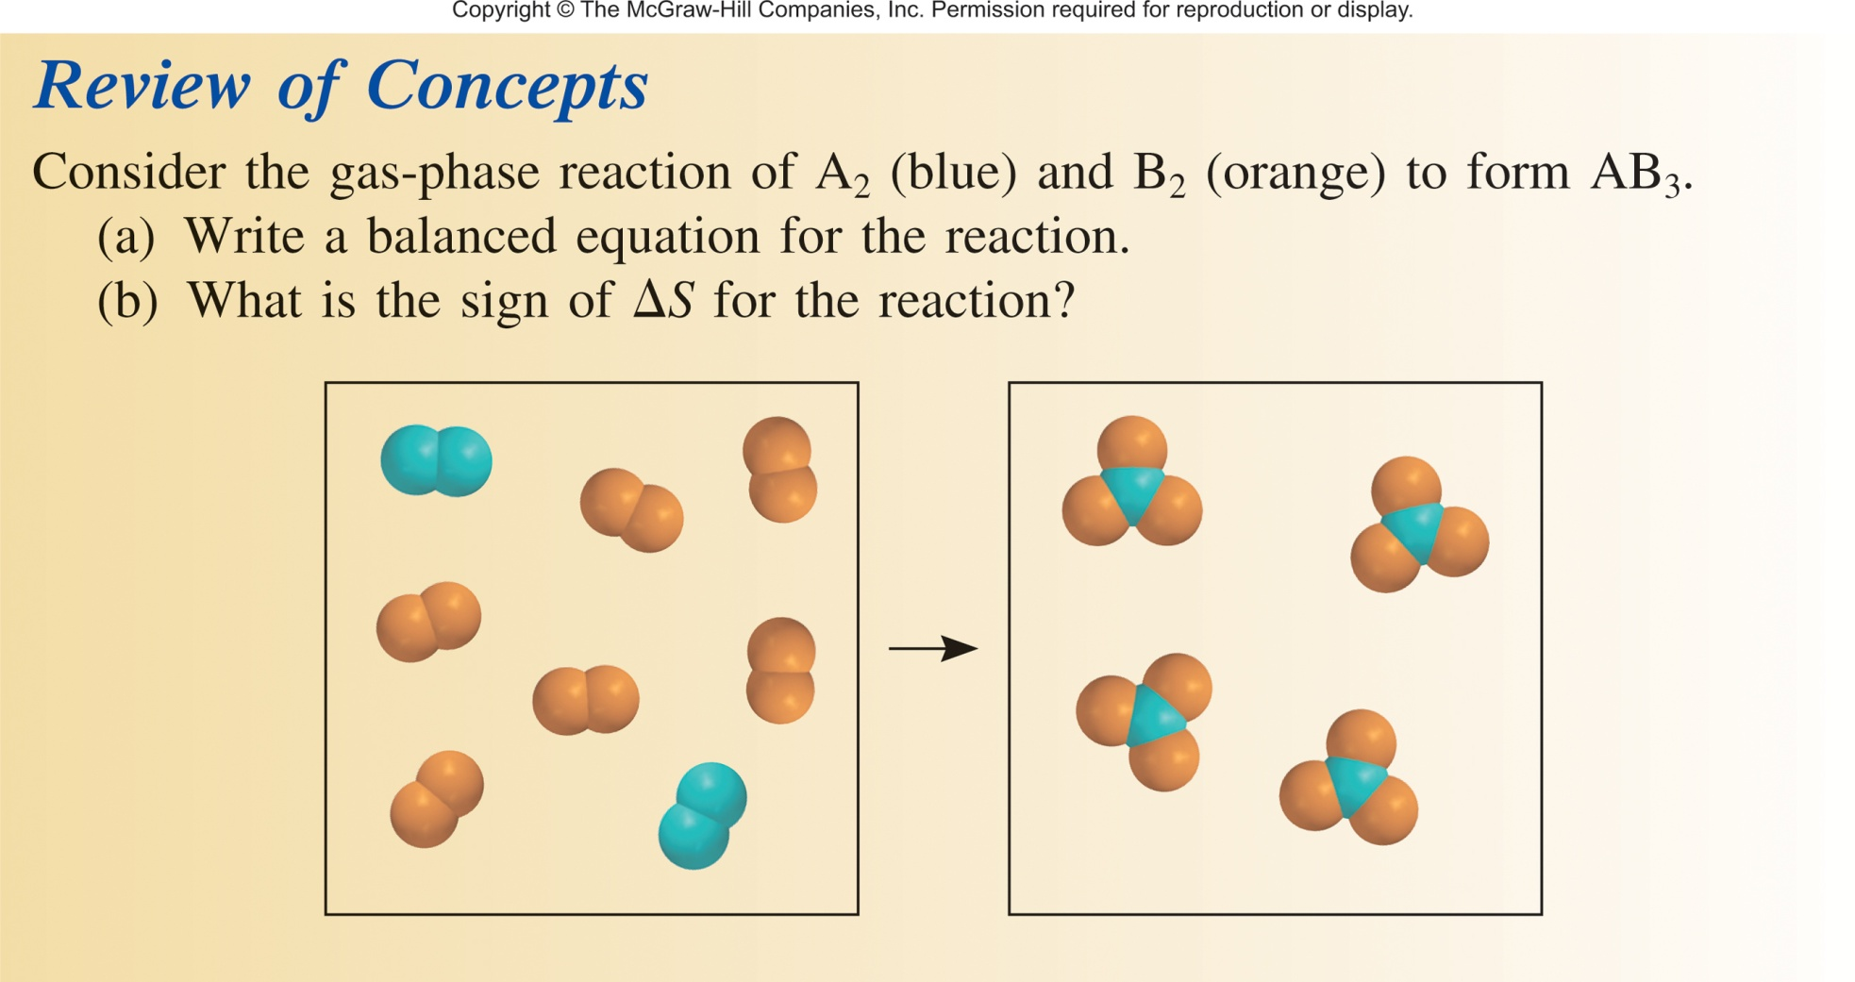

Slide 46
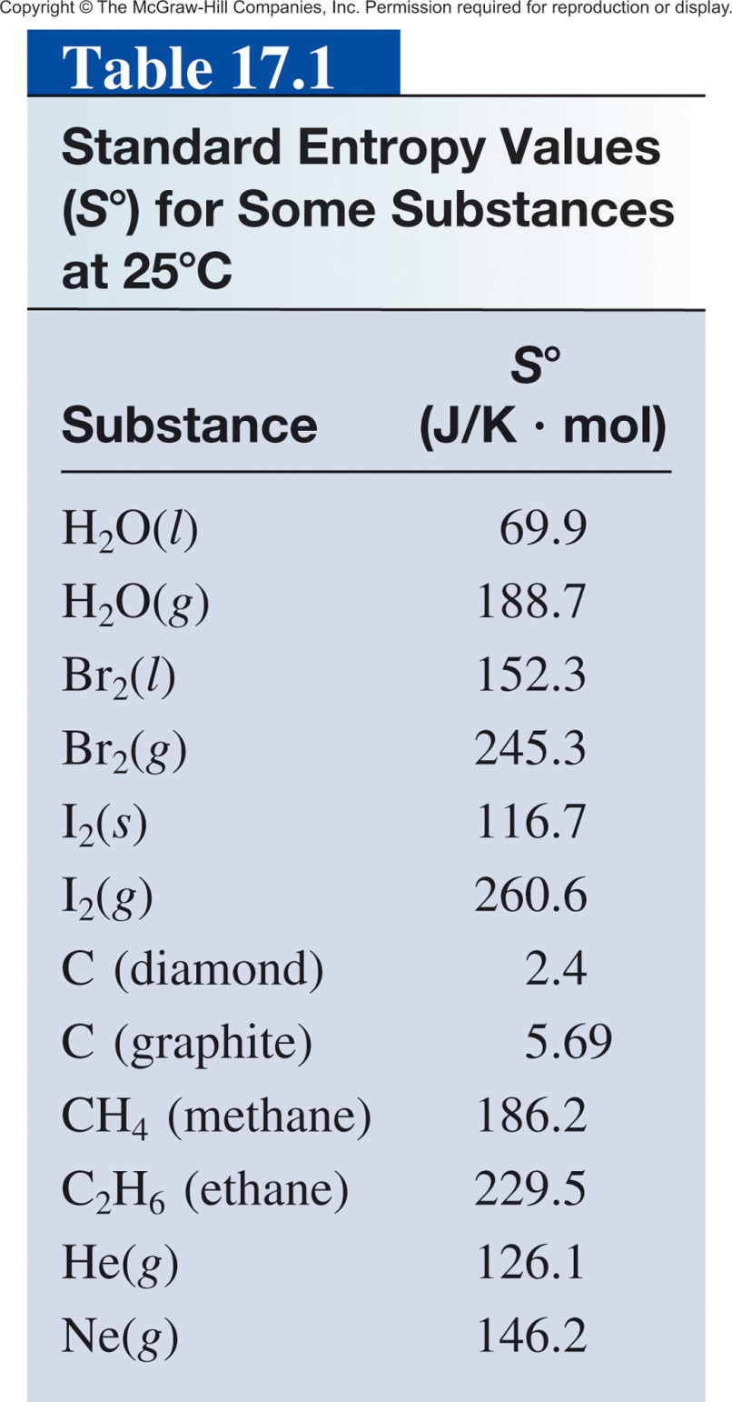
Standard Entropy
Difficult to count the number of microstates directly.
Measured by calorimetery.
Standard entropy (S°) absolute entropy of a substance at 1 atm (typically at 25°C)
Units of J K⁻¹ mol⁻¹
All positive values.
Absolute values (unlike ΔH which is relative)

Slide 47
Standard Entropy
Entropy for gas phase is greater than that of liquid or solid of same substance
  I₂ (g) > I₂ (s)
More complex structures have greater entropy
  C₂H₆ (g) > CH₄ (g)
Allotropes - more ordered forms have lower entropy
  Diamond > graphite
Can be used to calculate ΔS_{rxn} and ΔS_{sys}.

Slide 48
Chapter 17

Slide 49
Entropy
Entropy (S): Can be thought of as a measure of the randomness or disorder of a system.
order
S
disorder
S
- A measure of the loss of information in a transmitted message (Computer science/information theory).
A thermodynamic quantity representing the unavailability of a system's thermal energy for conversion into mechanical work.
A measure of how spread out or dispersed the energy of a system is among the different possible ways a system can contain energy.
- Is a measure of the number of specific ways (microstates) in which a thermodynamic system may be arranged.

Slide 50
Microstates and Entropy
4 and 0 = 2 microstates
More order, Less entropy
3 and 1 = 8 microstates
2 and 2 = 12 microstates
Less order, more entropy
Configurations (macrostates) associated with large numbers of microstates are said to be more disordered than those with fewer microstates.
The equilibrium state of a system is the most disordered configuration (largest no. of microstates) available.
The number of microstates is called the multiplicity (W) of the configuration.

Slide 51
Microstates and Entropy
The Austrian physicist Ludwig Boltzmann introduced a model to relate the total number of microstates (the multiplicity, W) to entropy (S).
Boltzmann constant (k)
S = k ln W
k = 1.38 x 10⁻²³J/K
Gas constant
units on S is J/K
Avogadro constant
Boltzmann was the founding father of statistical mechanics, a completely new way of thinking about theoretical physics. His work was ridiculed by his fellow professors.

Slide 52
Microstates and Entropy
S = k ln W
k = 1.38 x 10⁻²³J/K
4 and 0 = 2 microstates
S = 9.6 x 10⁻²⁵ J/K
More order, Less entropy
3 and 1 = 8 microstates
S = 2.9 x 10⁻²⁴ J/K
2 and 2 = 12 microstates
S = 3.4 x 10⁻²⁴ J/K
Less order, more entropy
has > than 3 times as much entropy as

Slide 53
Entropy and Cards
Hand | W
Royal flush (AKQJ10 in one suit) | 4
Straight flush (sequence in one suit) | 36
Four of a kind | 624
Full house (three of a kind plus a pair) | 3,744
Flush (five cards in the same suit) | 5,108
Straight (five cards in sequence) | 10,200
Three of a kind | 54,912
Two pairs | 123,552
One pair | 1,098,240
No pairs | 1,302,540
Total | 2,598,960
ln W | S (J/K)
1.39 | 1.92 x 10⁻²³
3.58 | 4.94 x 10⁻²³
6.44 | 8.89 x 10⁻²³
8.23 | 1.14 x 10⁻²²
8.54 | 1.18 x 10⁻²²
9.23 | 1.27 x 10⁻²²
10.91 | 1.51 x 10⁻²²
11.72 | 1.62 x 10⁻²²
13.91 | 1.92 x 10⁻²²
14.08 | 1.94 x 10⁻²²
Poker: The game that rewards the player with the hand that has the least entropy.
Table does not account for high card (the equivalent of enthalpy?).

Slide 54
Entropy and Reactions
“All” chemical and physical changes involve a change in entropy (ΔS) for the system.
A + B C + D
ΔS = S_{f} - S_{i}
S_{initial}
S_{final}
General Molecular Trends:
Structure/Phase (gas vs solid, etc.)
less structure =more states = more entropy
Temperature
higher temp = more energy states = more entropy
Number of particles/atoms
more particles = more states = more entropy

Slide 55
1) Structure/Phase
Increasing disorder
Increasing entropy (S)
For any substance, the solid state is more ordered than the liquid state and the liquid state is more ordered than gas state.
When a gas expands into a vacuum, its entropy increases because the increased volume allows for greater atomic or molecular disorder.
S_{solid} < S_{liquid} << S_{gas}

Slide 56
Entropy and Temperature
Higher temperature allows the system to access more vibrational and rotational states (increased # of microstates).
Low temp
High temp

Slide 57
Temperature and Phase Change
S increases slightly with T
S increases a large amount with phase changes

Slide 58
Number of Atoms/Particles
2 molecules
4 molecules
S_{fewer moles} < S_{more moles}
More atoms = more vibrational and rotational states
S_{fewer atoms} < S_{more atoms}

Slide 59
17.1
Predict whether the entropy change is greater or less than zero for each of the following processes:
(a) freezing ethanol
(b) evaporating a beaker of liquid bromine
(c) dissolving glucose in water
(d) cooling nitrogen gas from 80°C to 20°C
EtOH(l) → EtOH(s)
ΔS < 0
Br₂(l) → Br₂ (g)
ΔS > 0
C₆H₁₂O₆(s) → C₆H₁₂O₆ (aq)
ΔS > 0
ΔS < 0

Slide 60
Standard Entropy
Difficult to count the number of microstates directly.
Measured by calorimetery.
Standard entropy (S°) absolute entropy of a substance at 1 atm (typically at 25°C)
Units of J K⁻¹ mol⁻¹
All positive values.
Absolute values (unlike ΔH which is relative)
Can be used to calculate ΔS_{rxn} and ΔS_{sys}.

Slide 61
Chapter 17

Slide 62
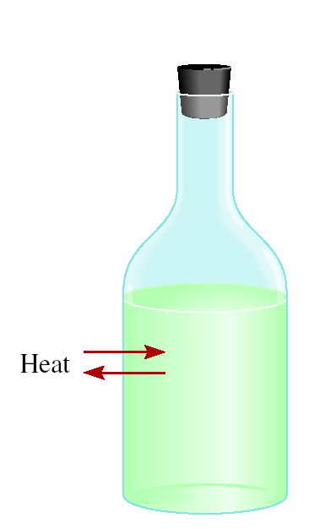
Thermodynamics
First Law of Thermodynamics
Energy can be converted from one form to another but energy cannot be created or destroyed.
Second Law of Thermodynamics
The entropy of the universe increases in a spontaneous process and remains unchanged in an equilibrium process.
ΔS_{univ} = ΔS_{sys} + ΔS_{surr}
surrounding
Equilibrium :
ΔS_{univ} = 0
system
Spontaneous process:
ΔS_{univ} > 0
If something happens the total entropy of the universe increases.

Slide 63
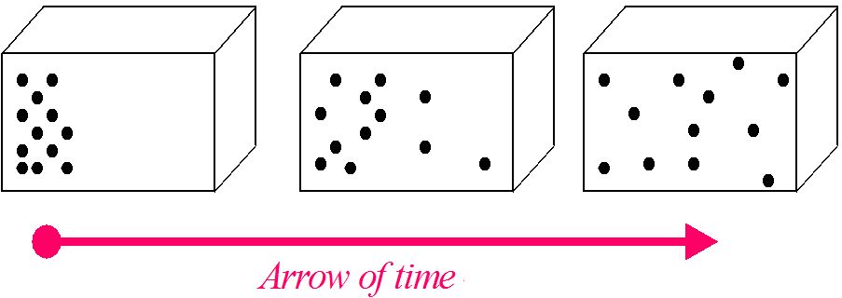
Side Note: Entropy and Time
Entropy is the only quantity in the physical sciences (apart from certain rare interactions in particle physics) that requires a particular direction for time, sometimes called an arrow of time.
Lower Entropy
Higher Entropy
As one goes "forward" in time, the second law of thermodynamics says, the entropy of an isolated system can increase, but not decrease.

Slide 64
Thermodynamics
First Law of Thermodynamics
Energy can be converted from one form to another but energy cannot be created or destroyed.
Second Law of Thermodynamics
The entropy of the universe increases in a spontaneous process and remains unchanged in an equilibrium process.
ΔS_{univ} = ΔS_{sys} + ΔS_{surr}
surrounding
Equilibrium :
ΔS_{univ} = 0
system
Spontaneous process:
ΔS_{univ} > 0
If something happens the total entropy of the universe increases.

Slide 65
Thermodynamics
For chemical reactions our system is the reaction and
ΔS_{sys} is ΔS⁰_{rxn}
The standard entropy of reaction (ΔS⁰ ) is the entropy change for a reaction carried out at 1 atm and 25⁰C.
rxn
surrounding
system
aA + bB cC + dD
Standard Entropy of Reaction (ΔS⁰_{rxn})- The difference between the sum of the entropies of the products and the sum of the entropies of the reactants:
ΔS⁰
=
Σ
nS⁰(products)
-
Σ
mS⁰(reactants)
rxn
ΔS⁰
-
[
aS⁰(A)
+
bS⁰(B)
=
[
cS⁰(C)
+
dS⁰(D)
]
]
rxn

Slide 66
17.3
Predict whether the Standard Entropy of Reaction (ΔS⁰_{rxn})of the system in each of the following reactions is positive or negative.
2H₂(g) + O₂(g) 2H₂O(l)
(b) NH₄Cl(s) NH₃(g) + HCl(g)
(c) H₂(g) + Br₂(g) 2HBr(g)
ΔS⁰
=
Σ
nS⁰(products)
-
Σ
mS⁰(reactants)
rxn
ΔSº_{rxn} < 0
ΔSº_{rxn} > 0
ΔSº_{rxn} = ?

Slide 67
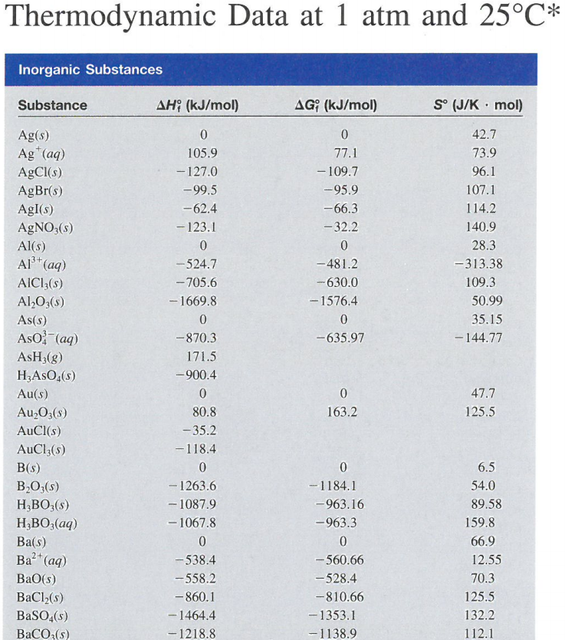
Calculating Entropy for a Reaction
aA + bB cC + dD
ΔS⁰
=
[
cS⁰(C)
+
dS⁰(D)
]
rxn
[
aS⁰(A)
+
bS⁰(B)
-
]
What is the ΔS⁰_{rxn} for:
2H₂(g) + O₂(g) → 2H₂O (l)
First, qualitatively predict the entropy change:
Increase, decrease or none

Slide 68
Entropy for a Reaction
From appendix 3:
H₂(g) S° = 131.0 J/Kmol
O₂(g) S° = 205.0 J/Kmol
H₂O(l) S° = 69.9 J/Kmol
2H₂(g) + O₂(g) → 2H₂O (l)
ΔS°_{rxn} = ΣnΔS°_{products} − ΣmΔS°_{reactants}
ΔS°_{rxn} = [(2)(69.9 J/K·mol)] - [(2)(131.0 J/K·mol) + (1)(205.0 J/K·mol)]

Slide 69
Entropy for a Reaction
From appendix 3:
H₂(g) S° = 131.0 J/Kmol
O₂(g) S° = 205.0 J/Kmol
H₂O(l) S° = 69.9 J/Kmol
2H₂(g) + 1O₂(g) → 2H₂O (l)
ΔS°_{rxn} = ΣnΔS°_{products} − ΣmΔS°_{reactants}
ΔS°_{rxn} = [(2)(69.9 J/K·mol)] - [(2)(131.0 J/K·mol) + (1)(205.0 J/K·mol)]
ΔS°_{rxn} = -327.2 J/K·mol
Entropy Decreases!

Slide 70
Entropy for a Reaction
2H₂(g) + O₂(g) → 2H₂O (l)
ΔS°_{rxn} = -327.2 J/K·mol
2H₂(g) + O₂(g) → 2H₂O (g)
ΔS°_{rxn} = ?
Greater than or less than - 327.2 J/K·mol ?
ΔS°_{rxn} = [(2)(188.7 J/K·mol)] - [(2)(131.0 J/K·mol) + (1)(205.0 J/K·mol)]
ΔS°_{rxn} = -89.6 J/K·mol
Entropy Decreases!
From appendix 3:
but by less:
H₂(g) S° = 131.0 J/Kmol
O₂(g) S° = 205.0 J/Kmol
H₂O(l) S° = 69.9 J/Kmol
H₂O(g) S° = 188.7 J/Kmol
2H₂O (l) → 2H₂O (g)
ΔS°_{rxn} = 237.6 J/K·mol

Slide 71
17.2
From the standard entropy values in Appendix 3, calculate the standard entropy changes for the following reactions at 25°C.
CaCO₃(s) CaO(s) + CO₂(g)
(b) N₂(g) + 3H₂(g) 2NH₃(g)
(c) H₂(g) + Cl₂(g) 2HCl(g)

Slide 72
17.2
From the standard entropy values in Appendix 3, calculate the standard entropy changes for the following reactions at 25°C.
CaCO₃(s) CaO(s) + CO₂(g)
(b) N₂(g) + 3H₂(g) 2NH₃(g)
(c) H₂(g) + Cl₂(g) 2HCl(g)
ΔS°_{rxn} = [S°(CaO) + S°(CO₂)] - [S°(CaCO₃)]
= [(39.8 J/K·mol) + (213.6 J/K·mol)] - (92.9 /K·mol)
= 160.5 J/K·mol
ΔS°_{rxn} = [2S°(NH₃)] - [S°(N₂) + 3S°(H₂)]
= (2)(193 J/K·mol) - [(192 J/K·mol) + (3)(131 J/K·mol)]
= -199 J/K·mol
ΔS°_{rxn} = [2S°(HCl)] - [S°(H₂) + S°(Cl₂)]
= (2)(187 J/K·mol) - [(131 J/K·mol) + (223 J/K·mol)]
= 20 J/K·mol

Slide 73
3 Laws of Thermodynamics
First Law of Thermodynamics
Energy can be converted from one form to another but energy cannot be created or destroyed.
Second Law of Thermodynamics
The entropy of the universe increases in a spontaneous process and remains unchanged in an equilibrium process.
Third Law of Thermodynamics
The entropy of a pure crystalline substance at absolute zero is 0.

Slide 74

3rd Law of Thermodynamics
Third Law of Thermodynamics
The entropy of a pure crystalline substance at absolute zero is 0.
Only 1 possible microstate!
This is the why we have an absolute entropy scale for substances.

Slide 75


3rd Law of Thermodynamics
Real Crystals
Experimentally we “can’t” get down to 0 K (absolute zero).
Absolute zero cannot be reached using only thermodynamic means, as the temperature of the substance being cooled approaches the temperature of the cooling agent asymptotically.
In September 2014, scientists in the CUORE collaboration cooled a copper vessel with a volume of one cubic meter to 0.006 Kelvins (−273.144 °C; −459.659 °F) for 15 days.

Slide 76
3rd Law of Thermodynamics
S = k ln W
W = 1
S = 0

Slide 77
Chapter 17

